Slide 1
Software Design Detail Report
Team LER: APH O&M Alexa Skill
Eric Schulze, Ryan Gosling, Larome Dickerson

Slide 2
Overview
Alexa O&M Trivia Skill
Used by APH to teach orientation and mobility to the blind and visually impaired

Slide 3
Data Design
Questions are stored as JSON objects.
The database will have a questions table; each JSON field will be an attribute in the table.
Questions passed between the many methods of the program.
{"questions":{[
"question":{
"id": "id_value",
"difficulty": "difficulty_value",
"question_text": "text_value",
"correct_answer": "answer_value",
"question_type": "type_value",
"answers": [
{"answer_text": "text_value"},
{"answer_text": "text_value"},
{"answer_text": "text_value"},
{"answer_text": "text_value"},
],
"additional_answer_info": "text_value",
}
]}
}

Slide 4

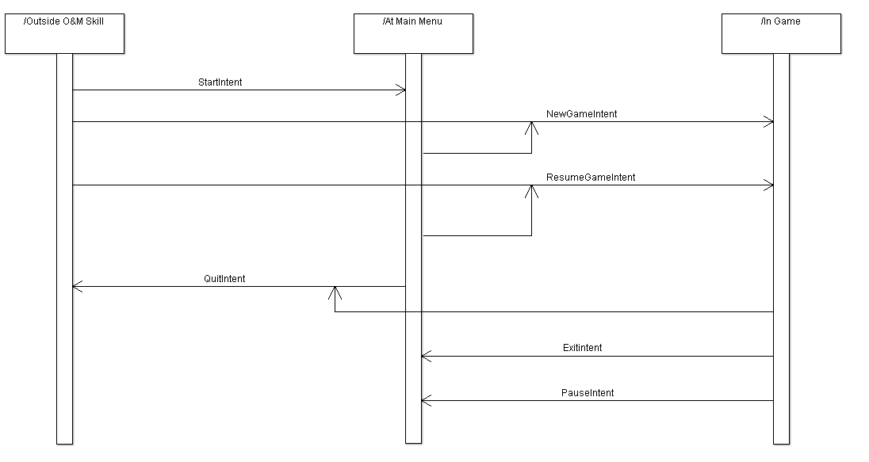
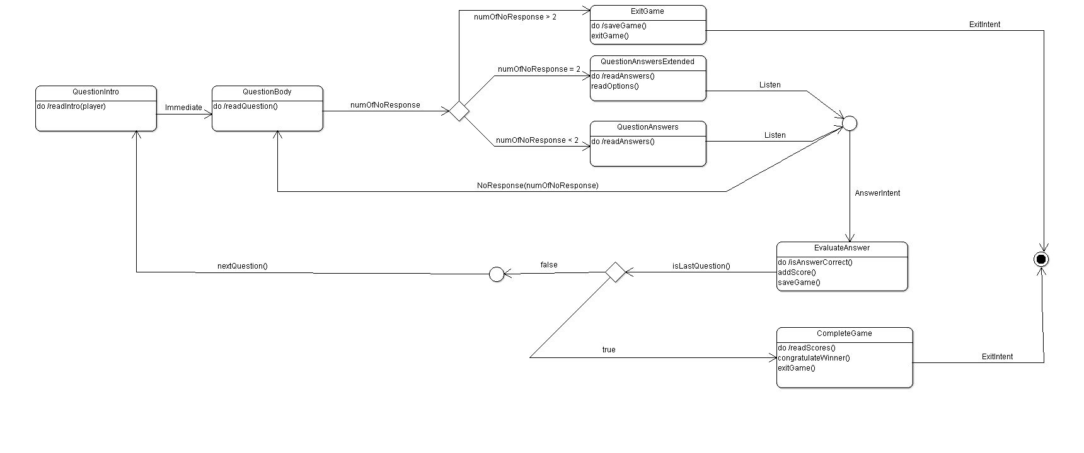
Architecture Design

Slide 5
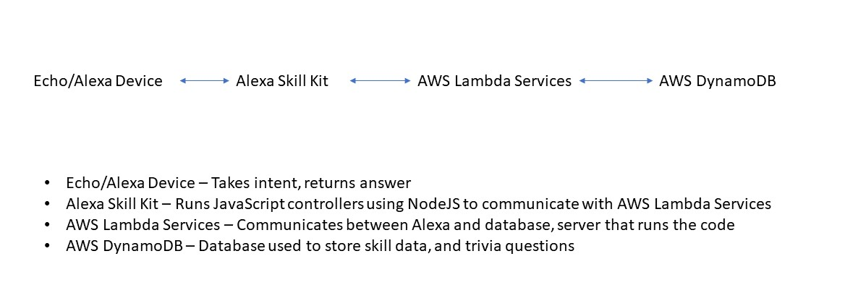
Interface Design

Slide 6
Procedural Design
GetIntent(Intent I)
StartGame(NumPlayers, Difficulty, SaveState
StartMain(SaveState)
QuitGame()
SaveGame(SaveState)
ReadIntro(QuestionNum, PlayerNum)
ReadQuestion(Question)
ReadAnswers(Answers)
ReadOptions()
GetQuestion(ListOfQuestionIDs)
IsAnswerCorrect(CorrectAns, GivenAns)
AddScore(Player, Score, Ans)
ReadScore(Player, Score)
Congratulate(Player)
Control(NumPlayers, Difficulty, SaveState)
GetNewQuestionSet(Difficulty)

